Slide 1
Database for Summary Dashboard
Truong Hoai Nam

Slide 2
Agenda

Slide 3
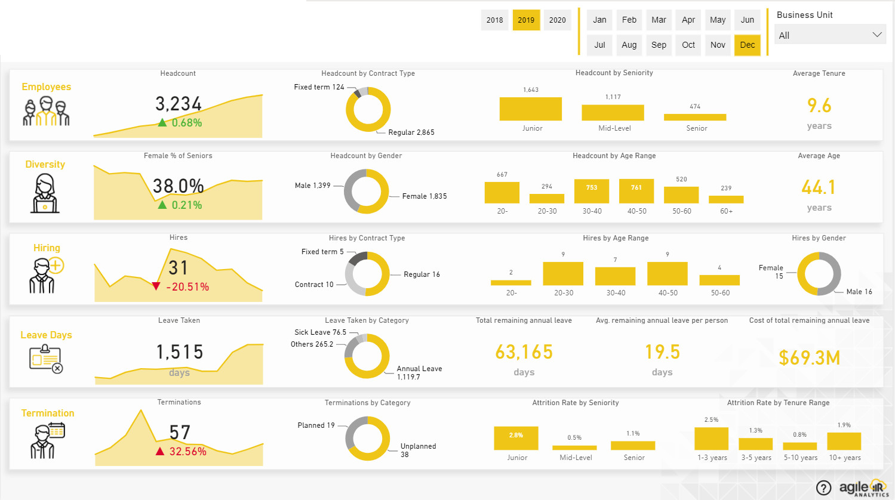
Summary Dashboard

Slide 4
General database
Link database: https://dbdiagram.io/d/PowerBI-66367af75b24a634d08297b4

Slide 5
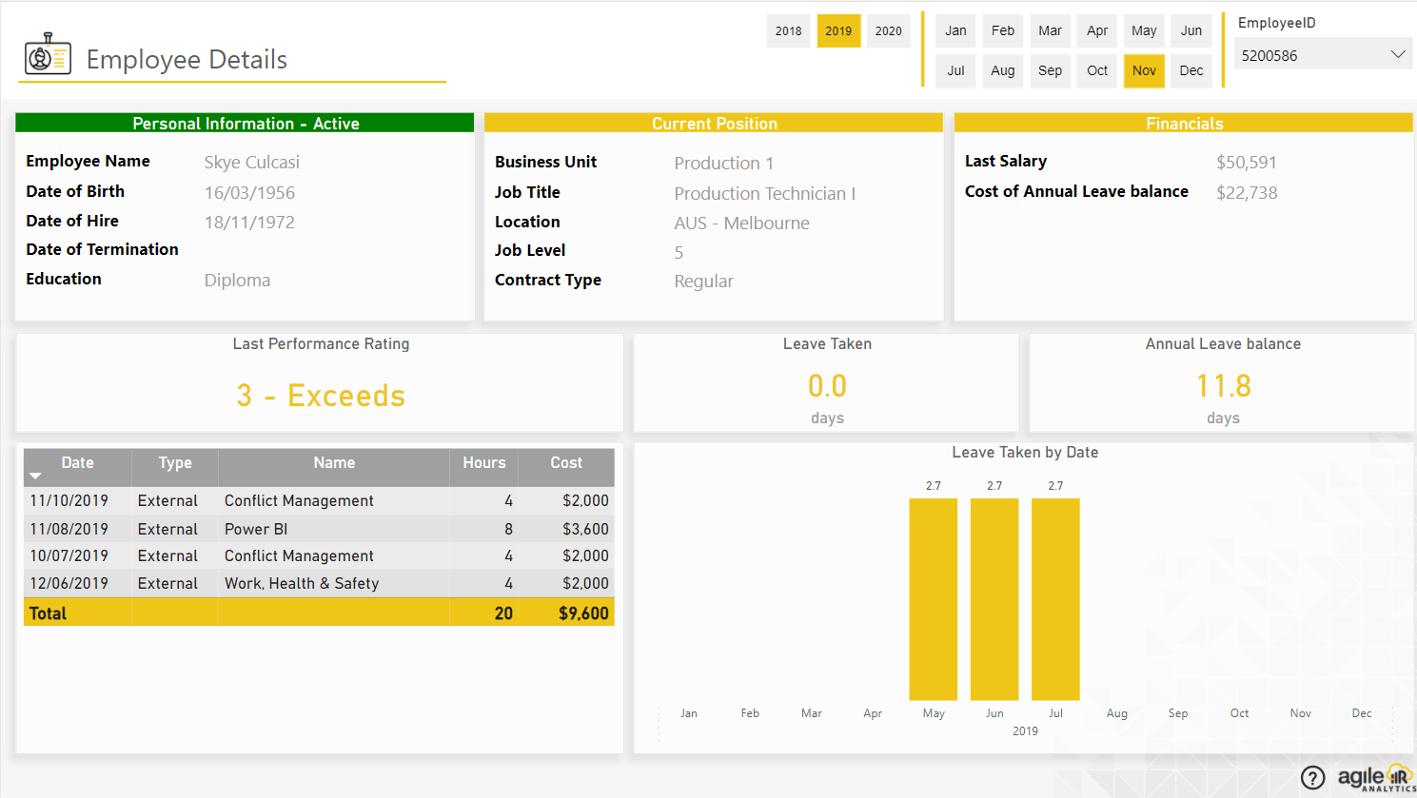
Employees

Slide 6
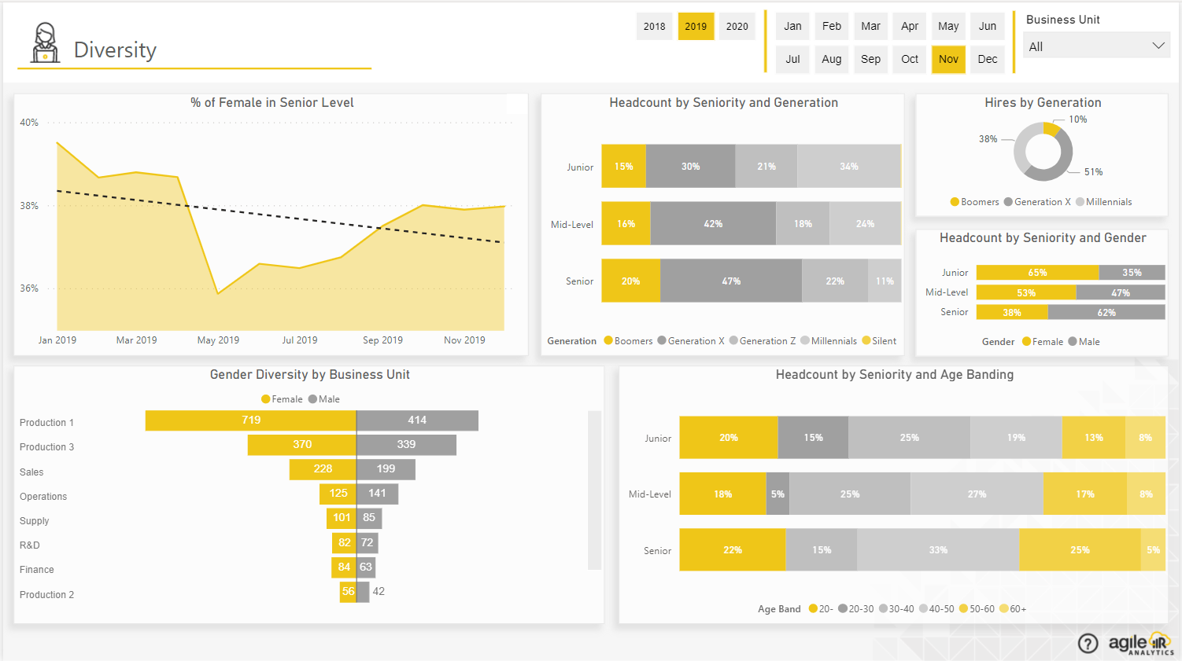
Diversity

Slide 7
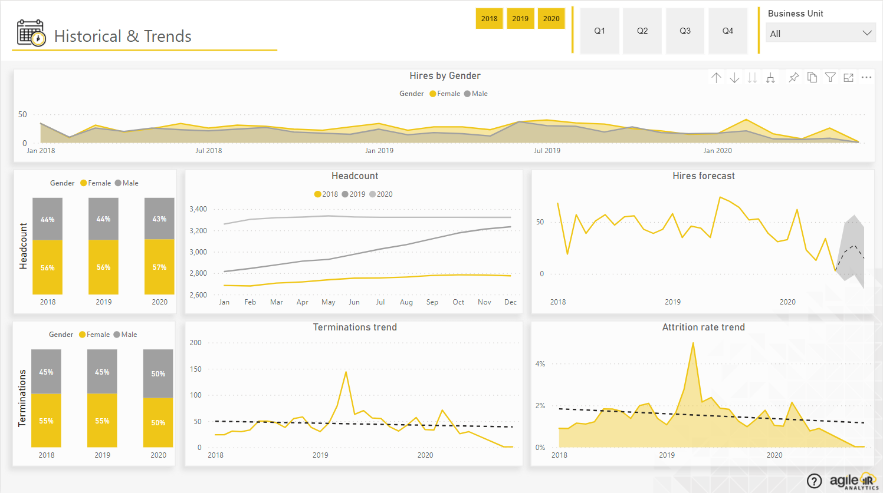
Hiring

Slide 8
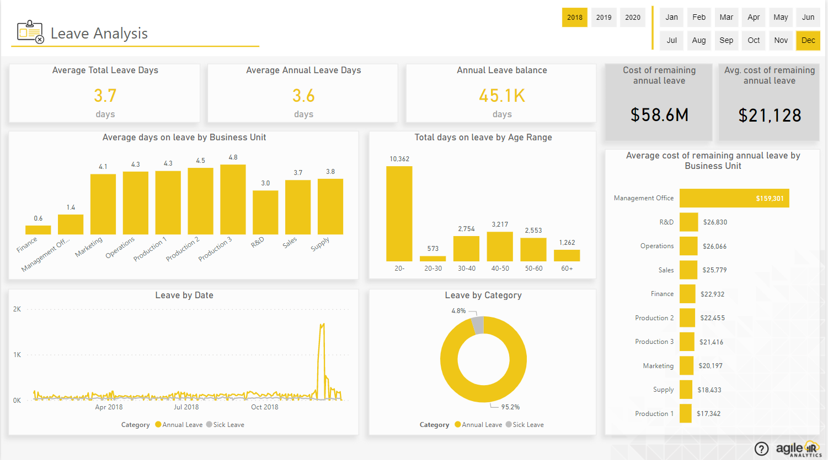
Leave Days

Slide 9
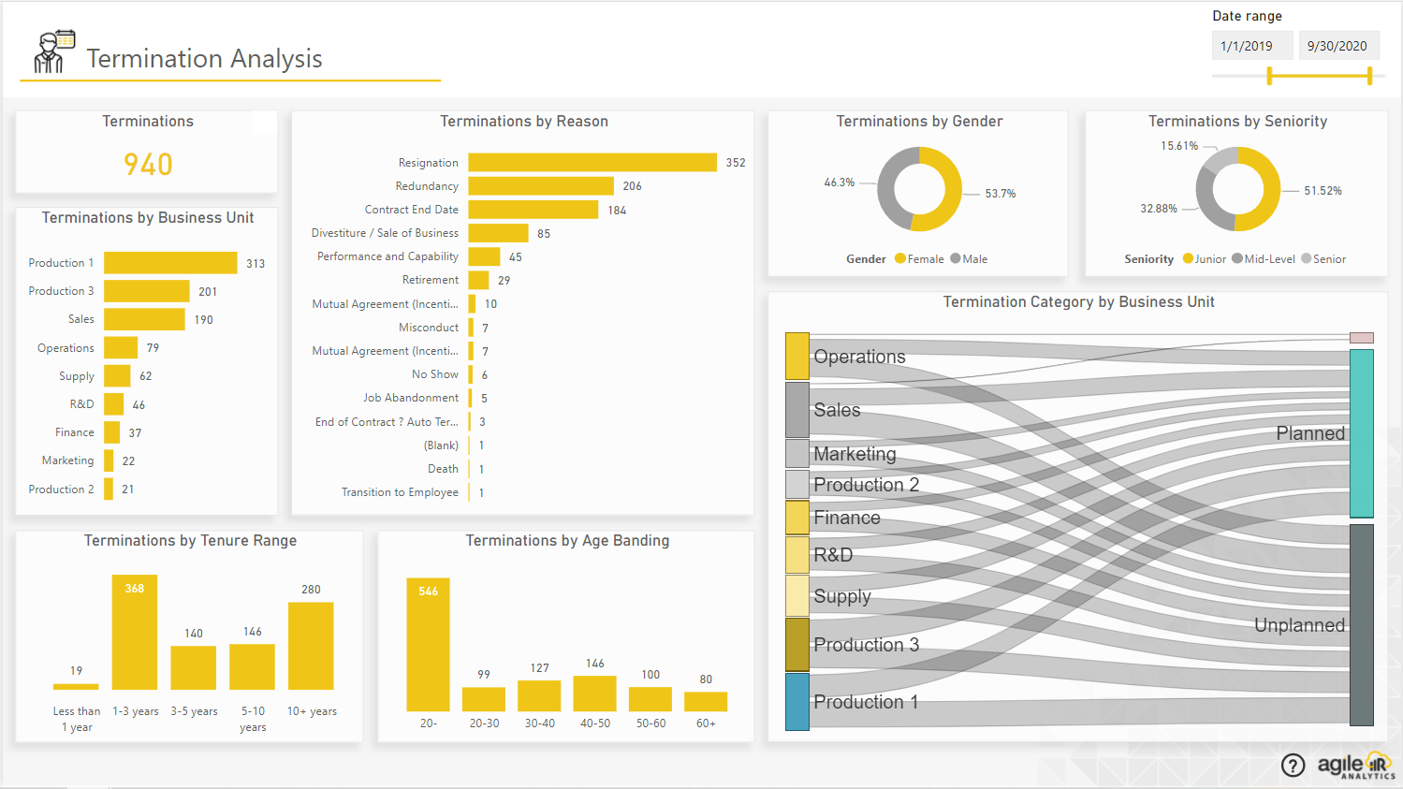
Termination

Slide 10

Thanks for watching

